Slide 1

Case Study: Spoofing Attack on Autonomous Vehicles.
Shihab Ud Doula | Matriculation No. 2190679.
Course: Project Work
Advisor: Prof. Dr.-Ing. João Paulo Javidi da Costa

Slide 2
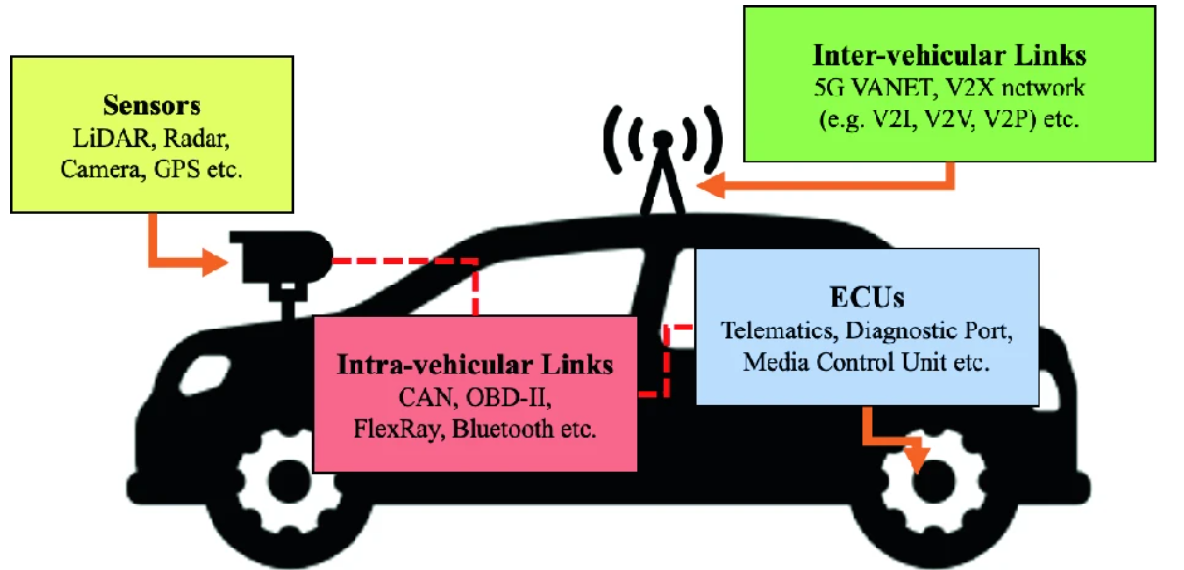
Understanding Spoofing in Autonomous Vehicles
Background: Autonomous vehicles (AVs) rely on GPS, time synchronization, and sensors for safe navigation. However, these dependencies make them vulnerable to spoofing attacks.
Problem Statement: Spoofing attacks can misguide navigation, disrupt system synchronization, and falsify environmental data, posing significant risks to safety.
Objectives:
Simulate spoofing attacks (GPS, time, and LiDAR)
Assess their impacts.
Propose mitigation strategies.
Fig: Vulnerable Attack surfaces of autonomous vehicles
Man Chun Chow, Maode Ma, and Zhijin Pan. Attack models andcountermeasures for autonomous vehicles. In Intelligent Technologies forInternet of Vehicles, pages 375–401. Springer, 2021.

Slide 3
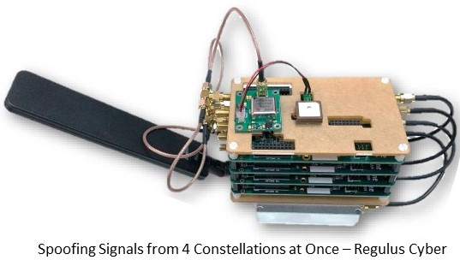
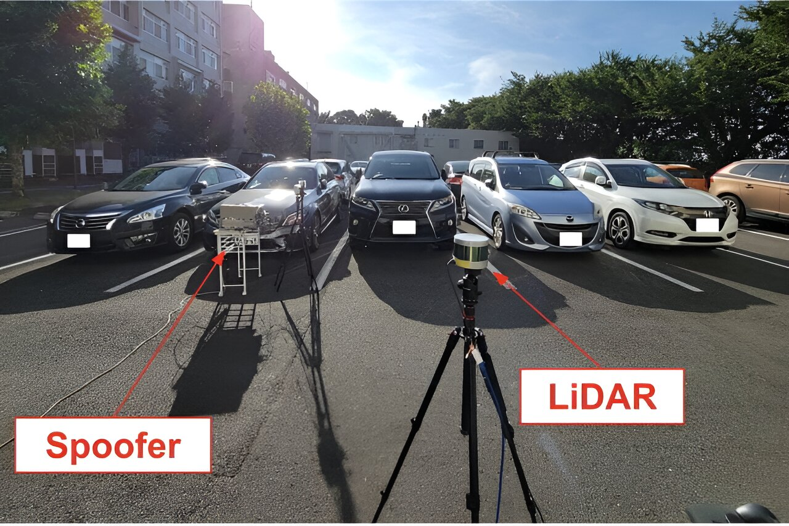
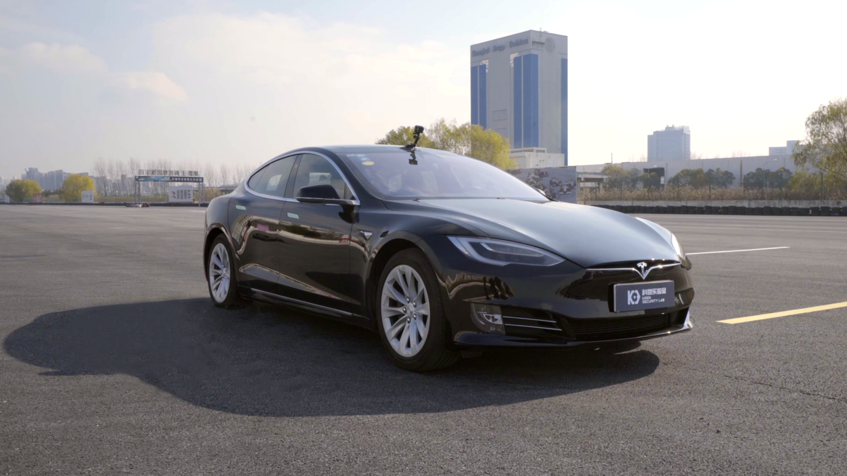
Research on Spoofing Attacks
GPS Spoofing (Regulus Cyber, 2019): Misguided navigation with fake GPS signals.
Time Spoofing (Keen Security Lab, 2019): System desynchronization causing critical errors.
LiDAR Spoofing (Cao et al., 2024): False obstacle detection via manipulated sensor inputs.
Editor. (2019, June 19). “We spoofed a Tesla and really scared our co-worker!” - Regulus Cyber - RNTF. RNTF. https://rntfnd.org/2019/06/19/we-spoofed-a-tesla-and-really-scared-our-co-worker-regulus-cyber-2/
User, S. (2024, March 8). Researchers uncover vulnerabilities in LiDAR technology for autonomous vehicles. https://route.ee/en/news/2487-researchers-uncover-vulnerabilities-in-lidar-technology-for-autonomous-vehicles
Lab, B. T. K. S. (2024, April 11). Tencent Keen Security Lab: Experimental Security Research of Tesla Autopilot. Keen Security Lab Blog. https://keenlab.tencent.com/en/2019/03/29/Tencent-Keen-Security-Lab-Experimental-Security-Research-of-Tesla-Autopilot/

Slide 4

Simulation Design and Tools
Tools:
MATLAB Live Script: Interactive computation and visualization.
System: Windows 11, Intel i5, 16GB RAM.
Setup:
Simulation duration: 10 seconds with 1000 time points.
Spoofing start points: 20–30% of the timeline, depending on the simulation.

Slide 5

Key Parameters:
GPS Spoofing:
Straight-line path with amplitude, frequency, and noise variations.
Time Spoofing:
Linear time signal with deviations
LiDAR Spoofing:
Constant distance of 20m with added linear drift and sinusoidal noise.

Slide 6
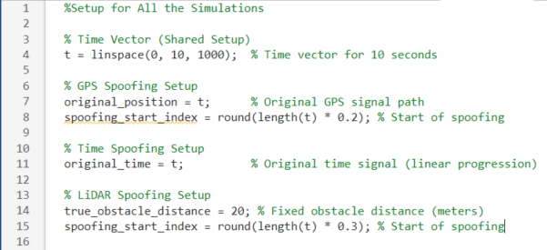
Code Setup for All simulation

Slide 7
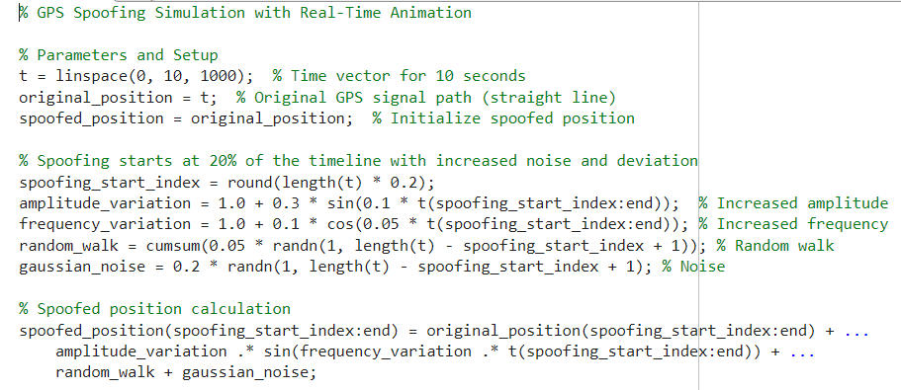
A GPS live script where parameter are defined

Slide 8
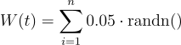
Key Components
Original Path: Straight-line trajectory (original_position = t).
Spoofing Elements:
Amplitude variation which Adds smooth oscillations.
Frequency variation which Adds periodic deviations.
Random walk which Introduces gradual drift.
Gaussian noise Simulates real-world randomness.
Analysed Metrics:
Position: Deviation of spoofed path from original.
Velocity and Acceleration: Effects on motion dynamics.

Slide 9
GPS Spoofing Simulation and Results
Overview:
Simulated GPS spoofing to observe its impact on position, velocity, and acceleration.
Spoofing starts at 2 seconds, introducing deviations through amplitude variations, frequency changes, random walk, and Gaussian noise.
Results highlight how spoofing disrupts the vehicle's navigation system by creating noticeable deviations in the trajectory.

Slide 10
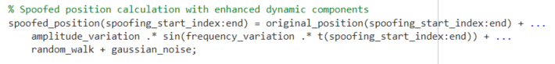
Main script for calculation
Key Logic for Spoofed Path Generation

Slide 11
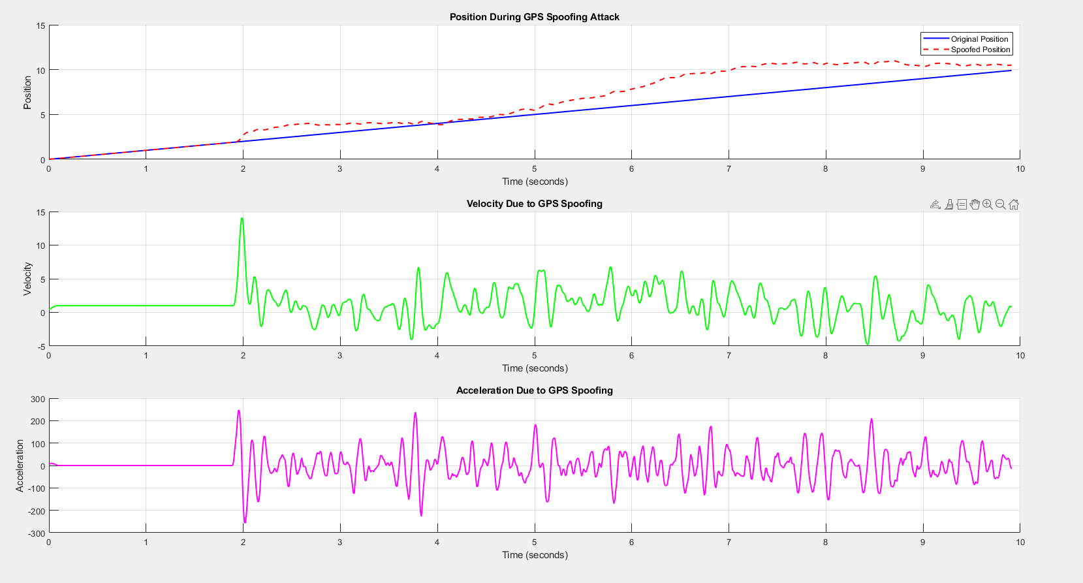
Results for GPS spoofing
Spoofing starts at 2 seconds
Peak deviation at 8 seconds
Velocity spikes after 2 seconds

Slide 12
Time Spoofing Simulation and Results
Overview:
Simulated time spoofing attack to observe its impact on GPS signals.
Spoofing starts at 20% of the timeline, introducing:
Linear drift: Mimics gradual timing errors.
Sinusoidal oscillations: Adds periodic disturbances.
Random noise: Simulates real-world signal disruptions.
Results highlight deviations in time signal, measurable offsets, and disturbances in signal stability.

Slide 13
Spoofing elements:
Linear Drift: Gradual time shifts using :
Sinusoidal Disturbance: Periodic variations modeled as:
Gaussian Noise: Adds random fluctuations using :

Slide 14
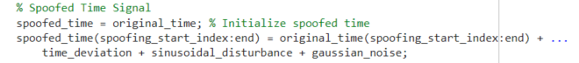
Main script for calculation
Demonstrates how drift, oscillations, and noise are combined to simulate the spoofed time signal.

Slide 15
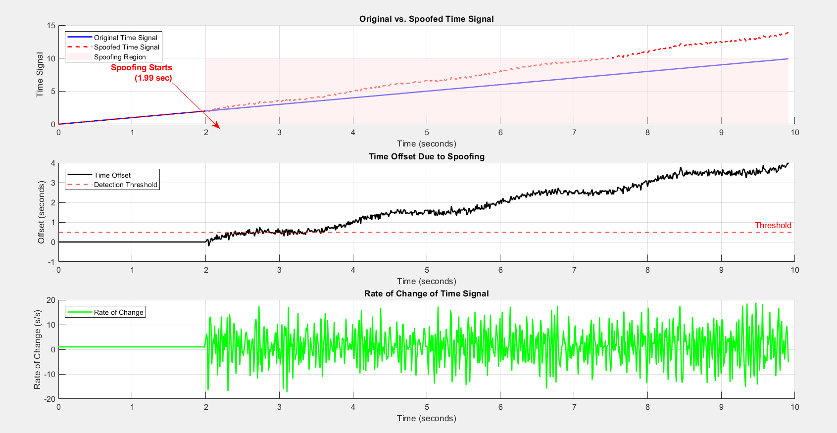
Results for time spoofing
Spoofing starts at 2 seconds, deviation increases
Offset crosses detection threshold at 3.7 seconds
spikes in the rate of change after spoofing starts.

Slide 16
Sensor Spoofing Simulation and Results
Overview:
Simulated sensor spoofing attack on LiDAR distance measurements to analyze its impact.
Spoofing begins at 30% of the timeline and ends at 60%, introducing:
Linear drift: Gradual increase in distance readings.
Sinusoidal disturbances: Mimics periodic fluctuations in distance.
Gaussian noise: Adds random variations to the data.
Results highlight deviations in measured distances and significant impacts on sensor accuracy.

Slide 17
Sensor Spoofing Elemets:
Linear Drift: Gradual shift using:
Sinusoidal Disturbance: Periodic fluctuations modeled as:
Gaussian Noise: Simulates randomness with:

Slide 18
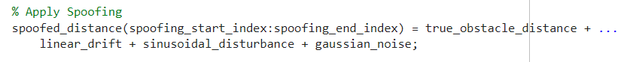
Main script for calculation
This code shows how the spoofing elements (drift, oscillations, noise) are combined to create a spoofed sensor reading.

Slide 19
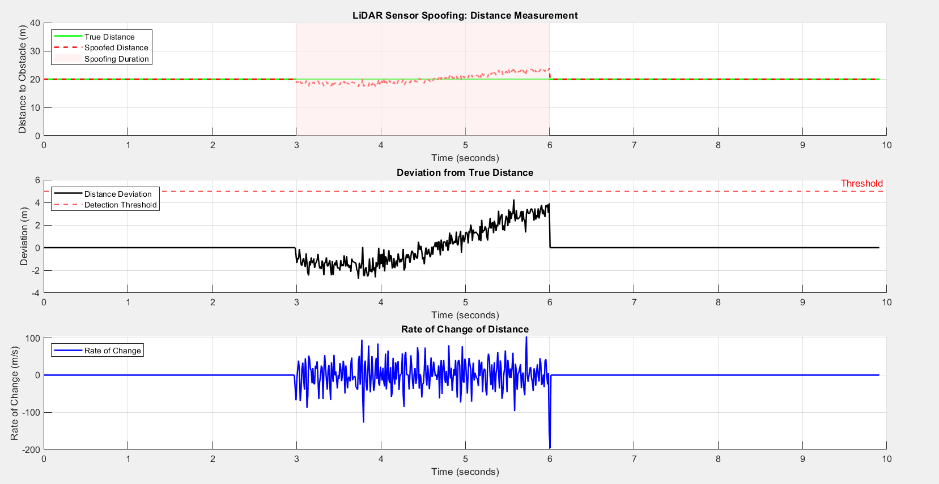
Results for sensor spoofing
Spoofing starts at 3 seconds and ends at 6 seconds.
Although this does not change major effect above the threshold.

Slide 20
Comparison of Spoofing Types
Process:
Simulated each spoofing type using unique dynamics.
Measured deviations, rate of change, and threshold crossing.
Metrics Evaluated:
Maximum Deviation (quantifies error severity).
Rate of Change (measures signal stability).
Threshold Crossing (detectability).
Spoofing Type | Max Deviation | Error Percentage | Noise Duration
GPS | 3.5 m | 35% | t =2 to 9 seconds
Time | 1.5 s | 15% | t =2 to 6 seconds
Sensor | 4 m | 20% | t =3 to 6 seconds

Slide 21
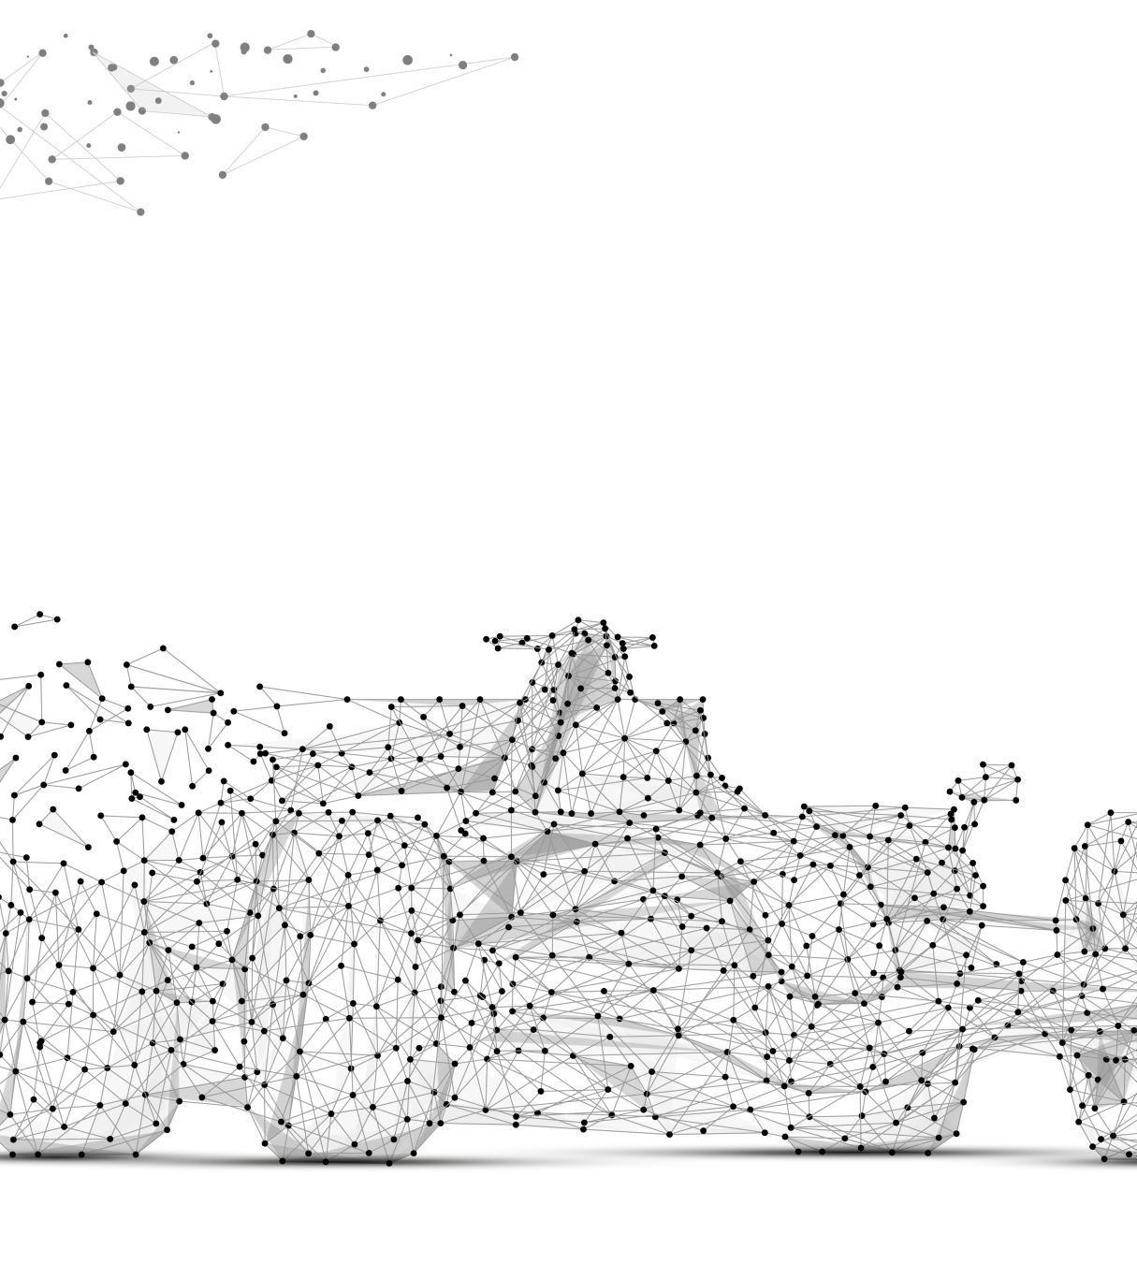
An Implementation of GPS Spoofing in Real World using API
Goal:
Simulate GPS spoofing effects on a vehicle’s movement.
Show incremental spoofing dynamics and their combined impact.

Slide 22
Step-by-Step Process
1. Original Path (Blue Line):
Real GPS route from dorm to university (via ORS API).
2. Incremental Spoofing Dynamics (Orange Line):
Amplitude Variation: Small oscillations.
Frequency Variation: Varying motion.
Random Walk: Gradual drift.
Gaussian Noise: Random jitter.
3. Major Spoof Event (Red Line):
All dynamics combined at 50% of the route.
Redirects the car to a wrong route fetched using ORS.
Demo In Next Slide

Slide 23
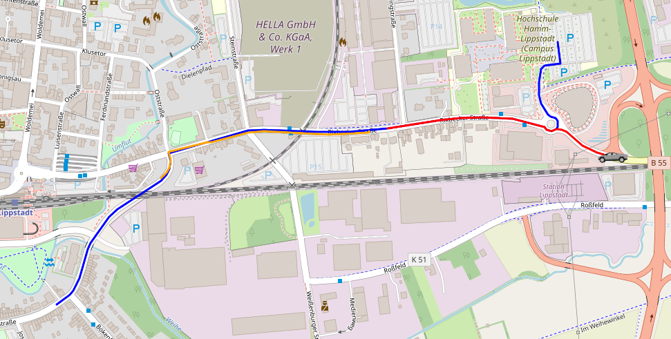
Incremental Effects: Oscillations, drift, noise (Orange line).
Major Spoof Event: Leads the car onto a wrong route (Red line)
Tesla Electric
Vehicle
Original Path: Blue line, fetched using ORS API.

Slide 24

Demo For Spoofing Attack

Slide 25
Original Demo
file:///C:/Users/shiha/OneDrive/Desktop/11th%20semester/Final%20Project/Javascript%20Visualisation%20-%20Attempt%20with%20Matlab%20-.html

Slide 26

Discussion and Insights
Findings:
GPS spoofing: Path deviations can misguide vehicles.
Time spoofing: Sync delays impact system reliability.
LiDAR spoofing: False readings compromise obstacle detection.
Challenges:
Balancing simplicity and realism in simulations.
Interpreting results in real-world contexts.

Slide 27

Conclusion and Future Work
Summary:
Spoofing attacks significantly disrupt AV safety and navigation.
Based on the parameter and the conducted experiments on chosen parameters , GPS spoofing has the most direct impact on navigation.
Future Directions:
Real-world testing to validate findings.
Developing countermeasures for spoofing detection.
Exploring combined spoofing scenarios for deeper insights.

Slide 28
References
1. Cao, X., Chen, L., Zhao, Y., & Wang, J. (2023). *Temporal consistency checks to detect LiDAR spoofing attacks on autonomous vehicles*. Retrieved from [https://arxiv.org/pdf/2106.07833.pdf](https://arxiv.org/pdf/2106.07833.pdf)
2. Li, Z., Li, J., & Liu, X. (2023). *GPS-IDS: An anomaly-based GPS spoofing attack detection framework for autonomous vehicles*. Retrieved from [https://arxiv.org/pdf/2405.08359v1.pdf](https://arxiv.org/pdf/2405.08359v1.pdf)
3. Wang, T., Zhang, P., & Liu, Y. (2023). *Unveiling the stealthy threat: Analyzing slow drift GPS spoofing attacks on autonomous vehicles*. Retrieved from [https://arxiv.org/pdf/2401.01394.pdf](https://arxiv.org/pdf/2401.01394.pdf)
4. Zhou, H., Jiang, K., & Wu, Y. (2022). *Simulation of sensor spoofing attacks on unmanned aerial vehicles using ROS and Gazebo*. Retrieved from [https://arxiv.org/pdf/2309.09648.pdf](https://arxiv.org/pdf/2309.09648.pdf)
5. Khan, A., Ahmed, R., & Bashir, U. (2023). *LiDAR spoofing attack detection in autonomous vehicles*. Retrieved from [https://ieeexplore.ieee.org/document/9730540](https://ieeexplore.ieee.org/document/9730540)
6. Kim, Y., Chen, M., & Smith, J. (2023). *Adversarial sensor attack on LiDAR-based perception in autonomous driving*. Retrieved from [https://arxiv.org/abs/1907.06826](https://arxiv.org/abs/1907.06826)
7. Liu, H., Zhao, J., & Lin, S. (2023). *Anomaly detection against GPS spoofing attacks on connected and autonomous vehicles*. Retrieved from [https://ieeexplore.ieee.org/document/10109166](https://ieeexplore.ieee.org/document/10109166)
8. Regulus Cyber. (2021). *Case study: Tesla autopilot spoofing attack*. Retrieved from [https://www.regulus.com/case-study-tesla-spoofing-attack](https://www.regulus.com/case-study-tesla-spoofing-attack)
9. Keen Security Lab. (2022). *Case study: Time spoofing vulnerabilities in autonomous driving systems*. Retrieved from [https://keenlab.tencent.com/en/autonomous-time-spoofing-case-study](https://keenlab.tencent.com/en/autonomous-time-spoofing-casestudy)
10. Park, J., & Lee, K. (2022). *Securing autonomous vehicles against GPS spoofing attacks: A deep learning approach*. Retrieved from [https://ieeexplore.ieee.org/abstract/document/10264063](https://ieeexplore.ieee.org/abstract/document/10264063)

Slide 29

Questions?

